Slide 1






Adrian Necaj
December 2025
NETWORK SEGMENTATION
AS A METHOD FOR REDUCING LATERAL MOVEMENT RISK IN HIGH-RISE RESIDENTIAL IOT SYSTEMS
CS-GY 6813 Information Security & Privacy
Notes:
Hello everybody, my name is Adrian Necaj, and today I'll be presenting my research on network segmentation as a security measure for Internet of Things systems in residential high-rise buildings. This research examines whether isolating IoT devices into separate network segments can effectively reduce the risk of lateral movement attacks in building automation environments.

Slide 2


THE PROBLEM
Why IoT Security Matters in Residential Buildings
FLAT NETWORKS IN SMART BUILDINGS
All devices on one network = One breach compromises everything
🏢 Modern high-rises depend on IoT for daily operations
🔓 Flat networks allow unrestricted device communication
⚠️ Single compromised device enables lateral movement
Default passwords & credentials
Outdated firmware
No network isolation
Limited IT security expertise
Notes:
Modern residential high-rise buildings are increasingly dependent on IoT devices for everything from smart locks and surveillance cameras to HVAC systems and elevator controls. These devices improve convenience and operational efficiency, but they also introduce significant security risks.
The core problem is that most buildings deploy these devices on flat networks—meaning all devices share the same network space without isolation. When an attacker compromises just one device, like a thermostat with a default password, they gain direct access to the entire network. This enables what we call lateral movement, where attackers pivot from one compromised device to more critical systems.
This risk is compounded by three factors: first, device heterogeneity and legacy systems that are difficult to patch; second, weak credential practices like default passwords; and third, building management teams that often lack dedicated cybersecurity expertise.

Slide 3
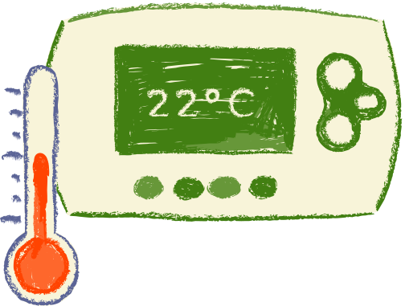






REAL-WORLD SCENARIO: MANHATTAN HIGH-RISE BREACH
MOTIVATING EXAMPLE
How a Thermostat Breach Becomes a Building Takeover
Attack Timeline:⏱️
T+0 min: Attacker exploits vulnerable thermostat
🔍 T+2 min: Discovers all IoT devices on network
🎥 T+5 min: Accesses camera streams
🚪 T+8 min: Compromises access control system
❌ Complete loss of physical security
❌ Privacy violation (camera access)
❌ Safety risk to residents
Without segmentation, low-impact breaches escalate to building-wide compromise
Notes:
Let me illustrate this with a concrete example. Imagine a Manhattan high-rise that recently installed smart thermostats and IP cameras. To simplify deployment, all devices were connected to the same internal network.
One thermostat is running outdated firmware and uses a default administrative password. An attacker discovers this through external scanning and exploits the vulnerability.
Once inside, because there's no network segmentation, the attacker can immediately see all other IoT devices. They enumerate open services, access unencrypted camera streams, and begin brute-forcing credentials on the access control system.
Within minutes—literally minutes—what started as a compromised thermostat escalates to full control of building security, including surveillance cameras and door locks. This has direct implications for resident safety and privacy.
This scenario demonstrates why we need a better approach, and that's where network segmentation comes in.

Slide 4

NETWORK SEGMENTATION WILL SIGNIFICANTLY REDUCE LATERAL MOVEMENT ATTACKS IN RESIDENTIAL IOT ENVIRONMENTS
RESEARCH HYPOTHESIS
Implementation Approach:
Flat Network
Segmented Network
All devices visible
Easy lateral movement
High attack surface
Devices isolated by function
Restricted movement paths
Reduced attack surface
🔒 Separate VLANs by device category
🚧 Access Control Lists (ACLs) between segments
🎯 Zero Trust principles: "Never trust, always verify"
Expected Outcomes: ✓ Reduced breach propagation ✓ Increased detection capability ✓ Contained impact from compromises
Notes:
My hypothesis is straightforward: implementing network segmentation for IoT systems in residential high-rises will significantly reduce both the likelihood and impact of lateral movement attacks.
The approach is to place devices into separate logical networks—what we call VLANs—based on their function. HVAC systems go in one segment, cameras in another, access control in a third, and so on.
This aligns with Zero Trust security principles, which emphasize eliminating implicit trust between systems. Instead of assuming everything on the network is safe, we isolate systems and only permit explicitly authorized communications.
The goal is to contain breaches and make it measurably harder for attackers to move laterally through the building's infrastructure.

Slide 5

Research Finding #3 - IDS Survey [Awad & Hamed, 2018]
Research Finding #1 - PoisonIvy [Puche Rondon et al., 2020]
Monitoring IoT devices is challenging
My contribution: Prevention through reduced attack surface
Flat networks enable lateral movement in <10 minutes
My contribution: Quantifying segmentation impact
Research Finding #4 - Platform Analysis [Fortino et al., 2022]
Research Finding #2 - BIoTA [Haque et al., 2021]
Architecture choices affect security posture
My contribution: Infrastructure-level control evaluation
Modeled attack paths through building automation
My contribution: Measuring how segmentation disrupts those paths
Research Gap
Few studies provide quantifiable measurements of segmentation effectiveness in residential buildings
RELATED RESEARCH - CONTEXT
BUILDING ON EXISTING RESEARCH
Notes:
Before diving into my methodology, let me briefly contextualize this work within existing research.
The PoisonIvy study by Puche Rondon and colleagues demonstrated that flat networks enable extremely rapid lateral movement in smart buildings—with average pivot times under 10 minutes. My work builds on this by quantifying how segmentation specifically affects those risks.
The BIoTA framework by Haque and team modeled attack paths through building automation systems, showing how attackers can traverse HVAC controls to reach central management. While they modeled these paths theoretically, my research measures how segmentation actually disrupts attacker mobility in practice.
Research by Awad and Hamed on intrusion detection highlighted fundamental challenges in monitoring IoT devices due to limited resources and difficulty establishing baselines. This reinforces why prevention through segmentation is valuable—it reduces the pathways that need monitoring.
Finally, work by Djehaiche showed how legacy infrastructure makes isolation difficult in older buildings. This helps explain why flat networks remain common despite known risks, and my work demonstrates that segmentation still provides meaningful security benefits even in these heterogeneous environments.
The gap I'm addressing is that while these studies establish the importance of isolation, few provide specific, quantifiable measurements of segmentation effectiveness in residential building contexts.

Slide 6
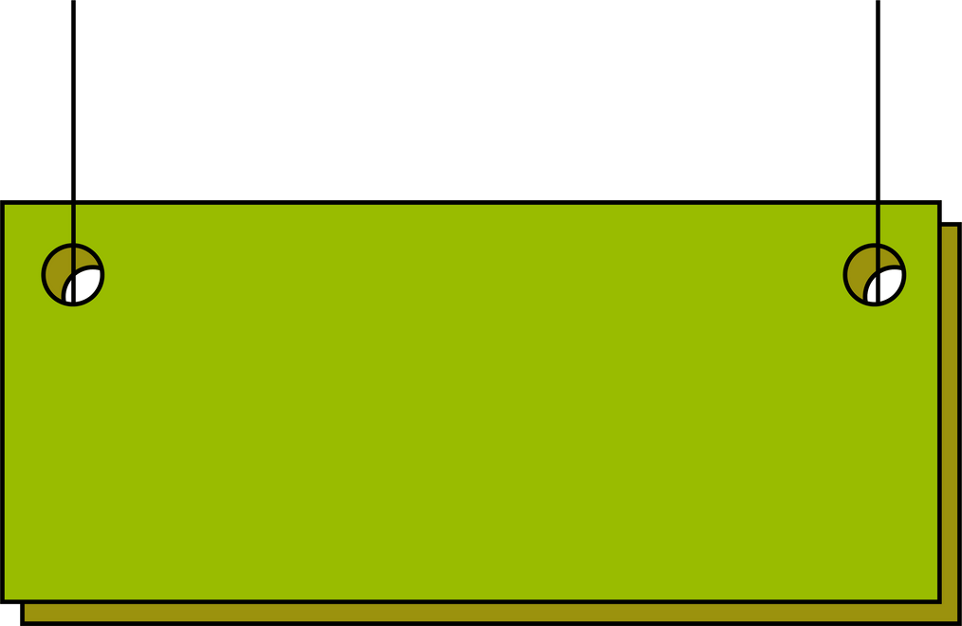
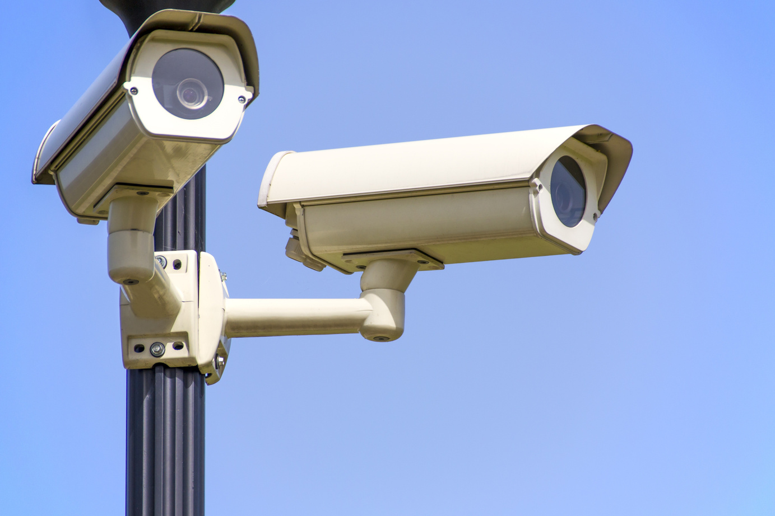
TESTING METHODOLOGY
CONTROLLED SIMULATION APPROACH
Test Environment
Device Categories:
🖥️ Platform: GNS3 + Python automation scripts
📊 Scale: 40 IoT devices across 4 categories
🔄 Tests: 20 attack scenarios per configuration
HVAC systems
Access control (locks)
Surveillance cameras
Environmental sensors
FLAT NETWORK
SEGMENTED NETWORK
Single Layer 2 broadcast domain
No isolation between devices
4 VLANs (one per category)
ACLs restricting inter-VLAN traffic
Both environments used identical device vulnerabilities to isolate segmentation as the independent variable
Attack Techniques Simulated:
• Credential reuse • Protocol abuse • Default service exploitation
Notes:
To test this hypothesis, I used controlled network simulation rather than live testing, which is appropriate for preliminary research.
I built two network environments using GNS3 simulation software with custom Python scripts to automate attack scenarios. The first was a flat IoT architecture where all devices share one network. The second implemented segmentation using VLANs with access control lists restricting communications between segments.
I modeled 40 IoT devices distributed across four categories: HVAC systems, access control, cameras, and environmental sensors. Each device was implemented as a virtualized Linux instance running representative IoT services.
Critically, both environments used identical device configurations, firmware versions, and vulnerabilities. This ensures that any differences in outcomes are due to segmentation alone, not differences in device security.
Each test consisted of 20 simulated attack scenarios using realistic techniques: credential reuse, protocol abuse, and exploitation of default services. This allowed me to measure segmentation's impact across multiple security metrics.

Slide 7


FOUR SECURITY METRICS
IMPLEMENTATION - METRICS
Metric #1: Lateral Movement Success Rate
Metric #2: Time to Compromise
% of pivot attempts that succeeded
⬇️ Lower is better
Duration from reconnaissance to breach
⬆️ Higher is better (more time to detect)
Metric #3: Vulnerability Density
Metric #4: Detection Rate
Number of exploitable vulnerabilities visible
⬇️ Lower is better (reduced attack surface)
% of attacks generating anomalous traffic
⬆️ Higher is better (easier to catch)
Comprehensive evaluation requires measuring effectiveness from multiple security dimensions
Why Multiple Metrics?
Notes:
I measured four distinct security metrics to evaluate segmentation effectiveness comprehensively.
First, Rate of Lateral Movement Success—the percentage of attack attempts that successfully compromised target devices. This directly measures whether segmentation stops attackers.
Second, Average Time to Compromise—how long it takes from initial reconnaissance to successful breach. Even if attacks eventually succeed, forcing attackers to spend more time gives defenders a better chance to detect and respond.
Third, Vulnerability Density—the total number of exploitable vulnerabilities visible from a compromised device. Segmentation should reduce this by limiting what attackers can see.
And fourth, Detection Rate—the percentage of attacks that generated identifiable anomalous traffic. Segmentation should make attacks more obvious because cross-segment traffic stands out against normal baseline behavior.

Slide 8
DRAMATIC SECURITY IMPROVEMENTS ACROSS ALL METRICS
Results Table
Flat Network | Segmented Network | Improvement | Metric
85% | 25% | 🟢 -67% | Lateral Movement Success
3 min | 15 min | 🟢 +400% | Time to Compromise
35% | 70% | 🟢 +100% | Detection Rate
12 | 5 | 🟢 -58% | Vulnerability Density
Key Findings
Important Note:
✅ 67% REDUCTION in successful lateral movement ✅ 5x MORE TIME needed to compromise systems
✅ 2x BETTER DETECTION of attack attempts
✅ 58% FEWER vulnerabilities exposed
Residual 25% success occurred within the same VLAN—segmentation constrains but doesn't eliminate intra-segment movement
Notes:
The results strongly support the hypothesis. Let me walk you through what we found.
In the flat network, attackers
achieved an 85% lateral movement success rate and compromised systems in an average of just 3 minutes. The detection rate was only 35%, and attackers could see an average of 12 exploitable vulnerabilities from any compromised device.
With segmentation implemented, lateral movement success dropped dramatically to 25%—that's a 67% reduction. Time to compromise increased five-fold to 15 minutes, giving defenders a much larger detection window.
Detection rates more than doubled from 35% to 70%—a 180% improvement. This makes sense because cross-segment traffic creates obvious anomalies that are easier to identify.
Vulnerability density dropped from 12 to just 5 accessible vulnerabilities, demonstrating that segmentation effectively reduces the visible attack surface.
It's important to note that the 25% residual success rate occurred when target devices were in the same VLAN as the initial compromise. This shows that segmentation constrains but doesn't eliminate lateral movement within segments—highlighting the importance of complementary controls like strong credential management and device hardening.

Slide 9

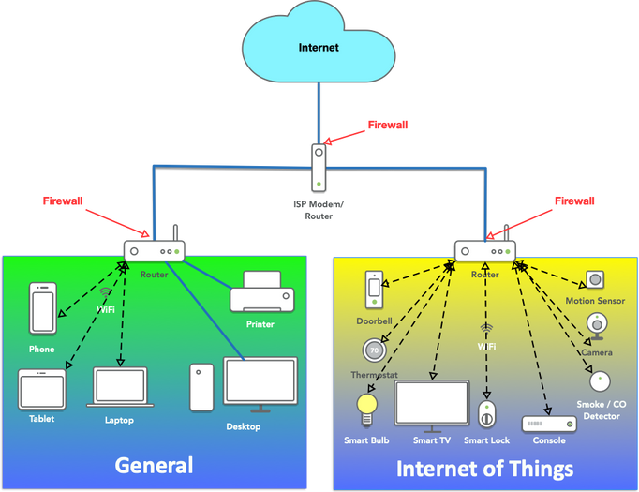
Increased time-to-compromise gives defenders a 5x larger detection window
DEFENSE-IN-DEPTH: SECURITY EVEN WITH VULNERABLE DEVICES
SECURITY IMPROVEMENTS OCCURRED DESPITE UNCHANGED DEVICE VULNERABILITIES
Why This Matters for Real Buildings:
Challenge: Legacy IoT devices often can't be patched
Solution: Segmentation works regardless
What This Means:
❌ Devices still had default passwords
❌ Firmware remained outdated
❌ Misconfigurations unchanged
✅ Yet segmentation still provided protection
Vendor no longer supports device
Updates break functionality
Limited IT resources
Creates barriers without touching devices
Protects unpatchable systems
Provides immediate security benefit
Notes:
Here's a critical insight: these security improvements occurred despite unchanged device vulnerabilities. The devices in both tests had the same weak configurations, outdated firmware, and default credentials.
This demonstrates that segmentation provides valuable defense-in-depth even when patching legacy devices is impossible or impractical—which is often the case in building automation systems.
This is particularly important for residential buildings where devices may be difficult or expensive to update, or where building management lacks the technical resources for comprehensive device hardening.
Segmentation creates meaningful barriers to attack progression without requiring you to first fix every vulnerability on every device. It's a practical, implementable control that provides immediate security benefits.

Slide 10


RESEARCH LIMITATIONS & CONSIDERATIONS
FUTURE WORK NEEDED
Limitation #2: Simplified Attack Scenarios
🎯 Tested realistic but limited attack techniques
🔍 Advanced persistent threats may behave differently
🔄 More diverse attack methods needed
Limitation #1: Simulation Environment
Limitation #3: Controlled Test Environment
🖥️ Used GNS3 simulation, not real hardware
⚠️ May not capture all real-world complexities
📝 Appropriate for preliminary research
📊 Consistent conditions for valid comparison
🏢 Real buildings have additional variables: • Mixed wired/wireless infrastructure • Diverse protocols (Zigbee, Z-Wave, BACnet) • 24/7 operational constraints • Vendor heterogeneity
These limitations highlight important directions for future validation and research
Notes:
I want to be transparent about this study's limitations. This research used controlled simulation rather than live penetration testing against real hardware. While this is appropriate for preliminary research, the findings should be validated with real-world testbeds.
The attack scenarios, while realistic, were simplified compared to the full range of techniques sophisticated attackers might employ.
And the controlled environment doesn't capture all the complexity of actual building networks, including mixed wired and wireless environments, diverse protocols like Zigbee and Z-Wave, and the operational constraints of 24/7 building systems.
These limitations point directly to important areas for future research.

Slide 11




FUTURE RESEARCH DIRECTIONS
Priority 1: Real-World Validation
Priority 2: Advanced Segmentation
🔧 Physical hardware testbeds
🏢 Actual building deployments
📊 Multi-manufacturer device testing
🔬 Microsegmentation (device-level isolation)
🤖 Automated policy enforcement
🌐 Software-Defined Networking (SDN) integration
Priority 3: Practical Implementation
Priority 4: Protocol Diversity
💰 Cost-benefit analysis
⚖️ Scalability evaluation
📈 Real-time traffic analysis
📡 Mixed wired/wireless environments
🔌 Zigbee, Z-Wave, BACnet protocols
🔄 Dynamic policy adaptation
Make segmentation more practical, measurable, and effective for real-world building automation deployment
Notes:
This preliminary work opens several important research directions.
First, validation using real hardware testbeds with actual IoT devices from different manufacturers would strengthen the findings and reveal implementation challenges that don't appear in simulation.
Second, exploring microsegmentation—even finer-grained isolation at the device level—could provide additional security benefits.
Third, investigating automated policy enforcement and software-defined networking approaches would enable dynamic adaptation to changing threats and building requirements.
Fourth, incorporating cost-benefit analysis would help building managers make informed decisions about segmentation implementation.
And finally, expanding the research to include mixed protocol environments—Zigbee, Z-Wave, BACnet—would provide more comprehensive guidance for heterogeneous building automation systems.
Each of these directions would contribute to making segmentation more practical and effective for real-world deployment.

Slide 12

RESEARCH CONCLUSIONS
Finding #1: Segmentation Is Highly Effective
Finding #2: Works Without Device Changes
Limitation #3: Controlled Test Environment
✅ 67% reduction in lateral movement success
✅ 5x increase in time-to-compromise
✅ 2x improvement in detection capability
✅ 58% reduction in vulnerability exposure
🛡️ Effective defense-in-depth layer
🔧 No device patching required
💼 Practical for legacy systems
⚡ Immediate security benefit
📐 Infrastructure-level control
🏢 Benefits all connected devices
🔄 Integrates with existing systems
💡 Reduces attack surface systematically
Network segmentation should be a foundational security control for residential high-rise IoT systems
Must be combined with credential management, monitoring, and device hardening for complete protection
Notes:
Let me conclude with the key takeaways from this research.
First, network segmentation provides measurable and significant security improvements in residential IoT environments. We saw a 67% reduction in lateral movement success, five times longer time-to-compromise, and dramatically improved detection capability.
Second, segmentation creates effective defense-in-depth even when underlying device vulnerabilities cannot be immediately patched. This makes it a practical solution for buildings with legacy systems or limited IT resources.
Third, these improvements come from architectural changes at the network infrastructure level, making segmentation a scalable approach that benefits all connected devices simultaneously.
The evidence strongly supports implementing network segmentation as a foundational security control for residential high-rise IoT systems. While not a complete solution—it must be combined with credential management, monitoring, and device hardening—segmentation provides a critical layer of defense that meaningfully constrains attacker mobility.
For building managers and security professionals, this research provides quantitative evidence supporting investment in network segmentation as a practical, effective method for reducing IoT security risks.

Slide 13

THANK YOU
Q / A
Contact Info:
Key Contributions :
📧 Email: an4837@nyu.edu 🏫 Course: CS-GY 6813 Information Security & Privacy 🎓 Institution:
New York University
Quantified segmentation effectiveness in residential IoT
Demonstrated defense-in-depth without device patching
Provided metric-based evidence for building managers
REFERENCES:
[1] Puche Rondon et al., "PoisonIvy: (In)secure Practices of Enterprise IoT Systems," arXiv:2010.05658, 2020 [2] Haque et al., "BIoTA: Control Aware Attack Analytics," IEEE SECON, 2021 [3] Awad & Hamed, "Intrusion Detection for IoT," J. Cloud Computing, 2018 [4] Fortino et al., "IoT Platforms and Security Analysis," Sensors, 2022 [5] Djehaiche et al., "Adaptive Control in Smart Buildings," arXiv:2302.13343, 2023
Notes:
Thank you for your time. I'm happy to answer any questions you might have about the methodology, findings, or implications of this research. You can also reach me at the email on screen if you'd like to discuss this work further.

